Slide 1
Organizational Effectiveness & Change
IMBA – 5th sem.

Slide 2
Organizational change
Organization change occurs when business strategies or major sections of an organization are altered

Slide 3
Planned & Unplanned Change

Slide 4
Change Agent
A change agent is a person from inside or outside the organization who helps an organization transform itself by focusing on such matters as organizational effectiveness, improvement, and development.

Slide 5
Organizational change: process
Kurt Lewin's change model

Slide 6
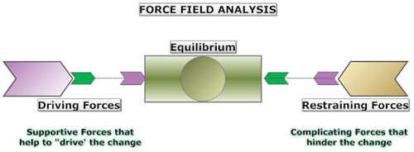
Force Field Analysis
Lewin extended his theory by including “force field analysis” which offers direction for diagnosing situations and managing change within organizations and communities.

Slide 7
Types of Organizational Change
Strategic
Structural
Process‐oriented
People‐centered

Slide 8
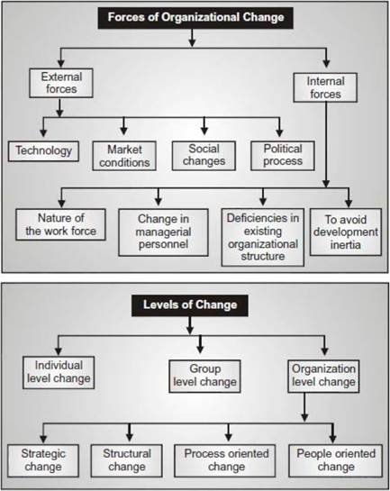
Forces for change
External Forces
Technology
Marketing Conditions
Social Changes
Political Forces
Internal Forces
Nature of the Work Force
Change in Managerial Personnel
Deficiencies in Existing Management Structure
To Avoid Developing Inertia

Slide 9
RESISTANCE TO CHANGE
Threats to the Power Structure
Structural Inertia
System Relationships
Vested Interest
Group Inertia
Organizational Structure
Threat to Specialization
Resource Constraints

Slide 10
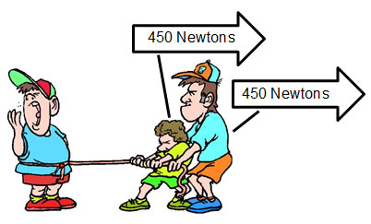
How to Overcome Resistance to Change in an Organization
Education and Communication
Participation and involvement
Facilitation and Support
Negotiation
Co-optation and manipulation
Explicit and implicit coercion

Slide 11
Kotter's 8-Step Model
John Kotter's 8-step change model is widely accepted across all industries as an effective model for implementing organizational change.

Slide 12
Applying Kotter's 8-Step Model
Establishing a Sense of Urgency
Creating the Guiding Coalition
Creating and Communicating a Vision for Change
Empowering Broad-Based Action
Generating Short-Term Wins
Build on Change
Make it part of the culture

Slide 13
ACTION RESEARCH
Action research refers to a wide variety of evaluative, investigative, and analytical research methods designed to diagnose problems or weaknesses—whether organizational, academic, or instructional—and help educators develop practical solutions to address them quickly and efficiently.

Slide 14
Action Research Model
Entry (Problem identification)
Contracting (Consultation with a behavioral science expert)
Diagnosis (Data gathering and preliminary diagnosis)
Feedback (Feedback to a key client or group)

Slide 15
ORGANIZATIONAL DEVELOPMENT
According to French and Bell, "Organizational development is a long range effort to improve an organization's problem-solving and renewal processes, particularly, through a more effective and collaborative management of organization culture with special emphasis on the culture of formal work teams with the assistance of a change agent or catalyst and the use of the theory and technology of applied behavior science, including action research“.

Slide 16
Organization Development Interventions
Individual or Interpersonal Level.
Team or group level.
Intergroup level.
Total organizational system level

Slide 17
Individual or Interpersonal Level Interventions
Coaching and Mentoring
Stress Management
Career Planning
Sensitivity Training
Job Redesign

Slide 18
Team or Group Level Interventions
Team Building
Process Consultation
Survey Feedback

Slide 19
Intergroup Level Interventions
Microcosm groups and inter-group conflict resolution
Third-party intervention

Slide 20
Total Organizational Level Interventions
Organization Development through Grid Training
Organization confrontation meeting
Reengineering or Techno-structural intervention
Structural Re-design
Strategic Interventions

