Slide 1
Organizational Effectiveness and Change
IMBA 5th sem

Slide 2
Issues and complexities in managing organizational change
Effective change management that makes all employees participate is essential in our world of turbulence and of shorter cycles of innovation.
Changes may affect every industry and every organizational function.
Management will only be able to successfully implement a new strategic direction, if they manage to gain the commitment of everyone within the organization. The point is to develop processes that enable all employees to learn about change and that to develop a culture of dialogue between management and workforce.

Slide 3
Challenges in Managing Change
The process of change has impact on the whole organization and on all individuals working there.
Change processes influence
What the organization does?
The way the organization does things.
The way all business units of the organization communicate and share information.

Slide 5
Barriers in Managing Change
Barriers of Perception
Emotional Barriers
Cultural Barriers
Environmental Barriers
Cognitive Barriers

Slide 6
Strategic role and impact of change on organizational performance
Below is a list of some of the key changes observed in organizational strategies over the years:
Heightened sensitivity to age differences in terms of recruiting, employee development, and employee relations policies.
More flexibility in work structure and policies such as dress code, telecommuting, and flexible hours.
Tailored rewards and recognition, especially in consideration of differences across generations.
Increased front-line supervisory training and development.

Slide 7
Learning organization
A learning organization is one that seeks to create its own future; that assumes learning is an ongoing and creative process for its members; and one that develops, adapts, and transforms itself in response to the needs and aspirations of people, both inside and outside itself .
Learning organizations foster an environment wherein people can "create the results they truly desire," and where they can learn to learn together for the betterment of the whole.
The following five disciplines that must be mastered when introducing learning into an organization:
Systems Thinking
Personal Mastery
Mental Models
Building Shared Visions
Team Learning

Slide 8
Single-Loop Learning & Double- Loop Learning
Single and double-loop learning-concepts have been developed by Chris Argyris and Donald Schön.
These theories are based upon “a theory of action” perspective designed by Argyris.
In single-loop learning, people, organizations or groups modify their actions according to the difference between expected and reached outcomes.
In other words, when something goes wrong or does not happen like we would like, most of us would consider how the situation could be fixed.
Single-loop learning can also be described like to be situation in which we observe our present situation and face problems, errors, inconsistencies or impractical habits. After that we adapt our own behavior and actions to mitigate and improve the situation accordingly.
Single-loop learning is operative level and it answers to the question “Are we doing things right?”

Slide 9
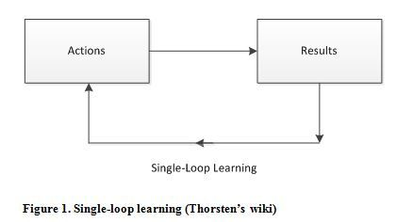

Slide 10
Single-Loop Learning & Double- Loop Learning
Double-loop learning is a part of “a theory of action” designed by Chris Argyris.
Single-loop learning is characterized by the fact that we changed our action or behavior to fix or avoid mistakes. In double-loop learning also, we can correct or change the underlying causes behind the problematic action.
In double-loop learning we are forced to think about our actions in the framework of our operating assumptions.
We should ask ourselves “what is going on here?” and “what are the patterns?”.
Double-loop learning will lead to deepen understanding of our assumptions and better decision-making in our everyday operations.
We also need to notice that double-loop learning leads to organizational learning.

Slide 11
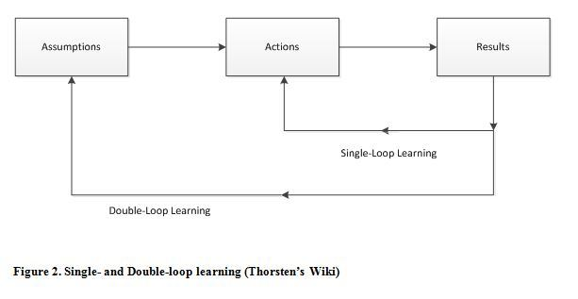

Slide 12
The political dynamics of organizational change
Organization is an ongoing, political process. It is continuously (re-)enacted through the everyday, power-related interactions of people.
What people come to see as ‘the established order’, ‘disorder’, and ‘new order’ emerge from these ongoing, conversational interactions.
Some of these exchanges occur in line with the formally acknowledged, ‘legitimate’ themes and practices.
According to conventional management theory, managers use a number of formal interventions to bring about the changes that they have settled upon.

Slide 13
Ethical issues related to change
Innovation and change are inevitable processes in the business world however giving due consideration to the role of ethics and responsibility as you move forward is equally important.
Employees
One of the primary responsibilities of leading change and innovation is the need to keep your employees in mind as you implement changes.
As you plan for changes, assess the impact the changes will have on your employees.
Disruption
Change and innovation are disruptive, not only to workers, but to everyone involved with your business. This disruption requires that business owners take into account everyone involved in the process of change.
The disruption caused by change and innovation will have outcomes that need to be planned for, and the business owner should do everything possible to preserve the rights and interests of others, rather than trampling to accomplish a goal.
The Business Institute Roundtable for Corporate Ethics notes that business owners should make efforts to not treat stakeholders as a mere means to an end.
Communication
Ethics plays a role in the process of change and innovation in terms of the need for open and honest communication among employers and employees, and between the company and the public.
Communication needs to be transparent during the process of change so that continued trust in the organization will continue to exist once the changes have been completed.
Companies that are not up front about the changes taking place may lose the trust of their employees, and possibly of the community as well, depending upon the nature of the business and its involvement in the community.
Teamwork
Ethical behavior towards the community and employees will help the business owner to build a stronger organization.
The responsibility of the business owner and manager is to make innovation and change a process that affects and benefits everyone.
Giving all involved a stake in the outcome, and treating them in an ethical manner in the process, will bring greater results in the long run.

Slide 14
Sources of Organizational Ethics
Societal
Professional
Individual

Slide 15
Creating an Ethical Organization
Establish your ethical stance.
Eliminate double standards.
Create a respectful environment.
Know your employees.
Make ethics visible.
Encourage workers to report illegal or unethical conduct.
Create a clear path to reward and recognition.
Redress concerns.

Slide 16
Role of vision in organizational change.
Vision is strongly linked to successful organizational change.
Significant organizational change occurs, for example, when an organization changes its overall strategy for success, adds or removes a major section or practice, and/or wants to change the very nature by which it operates.
Leaders and managers continually make efforts to accomplish successful and significant change.
A clear vision provides the direction in the which the company wants to go.
Are you aspiring to make some kind of change, and how will you make it? Vision gives the answer.
Vision provides a foundation for planning our actions, helping us to understand the gap between the present and the desired future state.
It helps people to understand what the change process will look and feel like, making it more real for them.
Its attractiveness encourages commitment to the new future.
A vision is therefore much more than just a strapline or goal and performs a vital role in the process of engaging others and shaping the change programme.

